Slide 1
Major Revision 2 Texas Precipitation Gradient (2017)
Major Revision 2 requested by PeerJ
By Sean Kinard

Slide 2
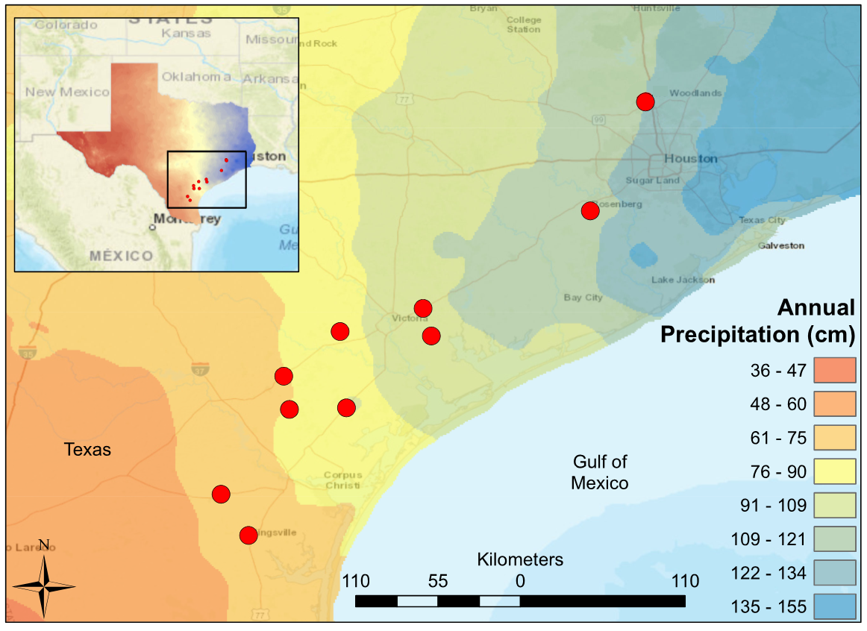
Figure 1: Map of South-Central Texas, where 10 USGS gauged streams were sampled in the spring of 2017. An annual precipitation overlay indicates that sample sites spanned a gradient from 61 cm/yr in the Southwest to 134 cm/yr in the Northeast.

Slide 3
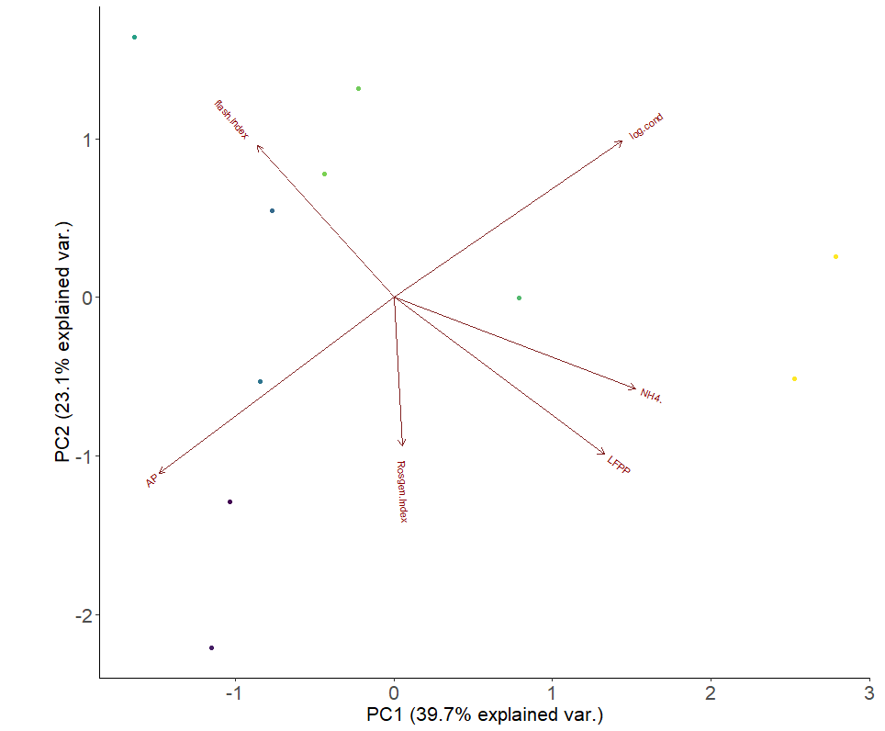
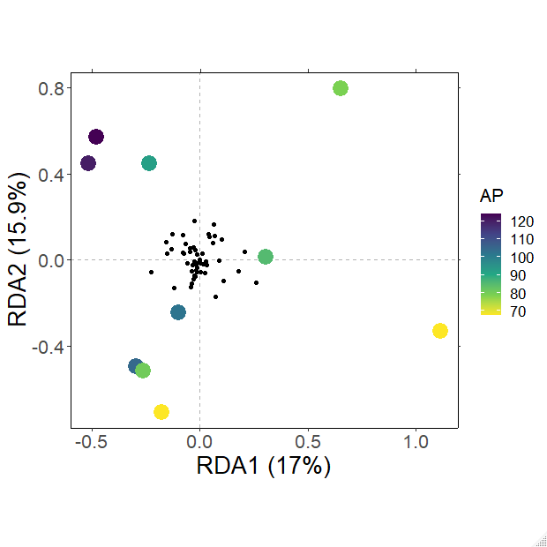
Flashiness
Conductivity
Figure 2: Principal Component Analysis of environmental predictors at 10 sites spanning a precipitation gradient along the Texas Coastal Prairie. Circles representing sample sites are colored based on their annual precipitation. Axes labels include the percentage of variance explained by the first principal component (horizontal axis) and the second principal component (vertical axis).
PC1 (23.1%)
NH₄⁺
Precipitation
Channel Shape
Low Flow
Pulse %
Precipitation
(cm/yr)
PC1 (39.7%)

Slide 4
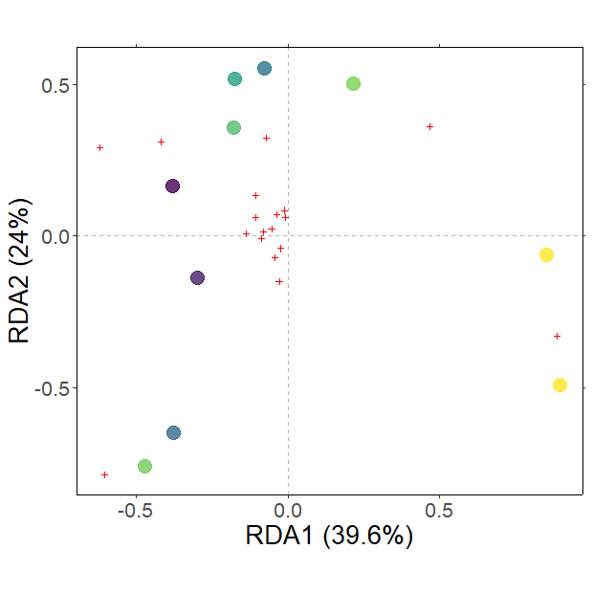
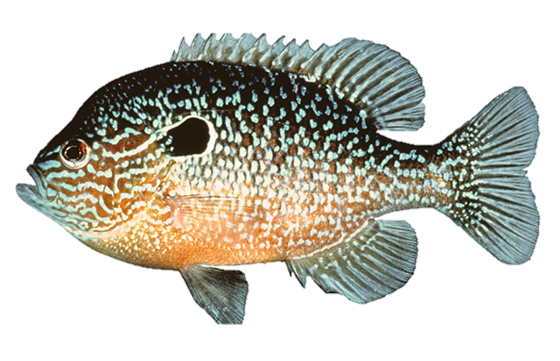
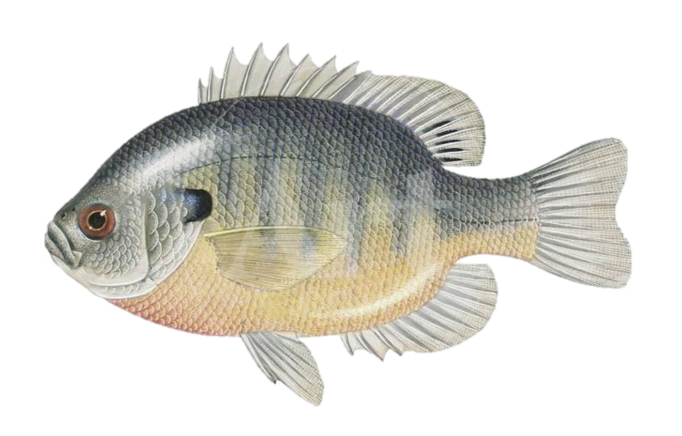
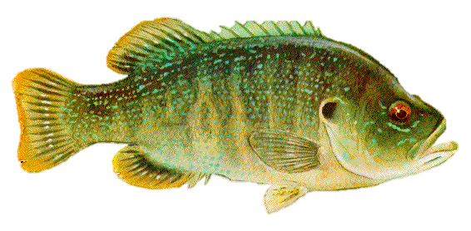
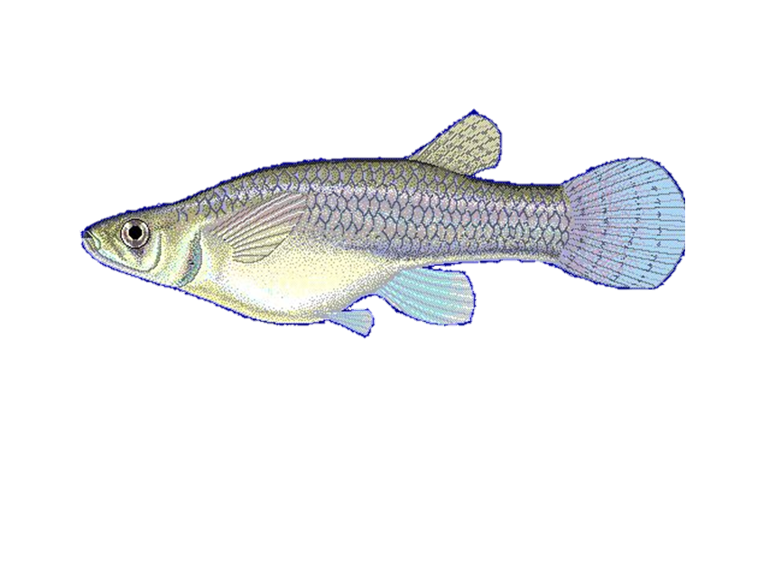
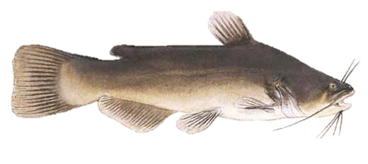
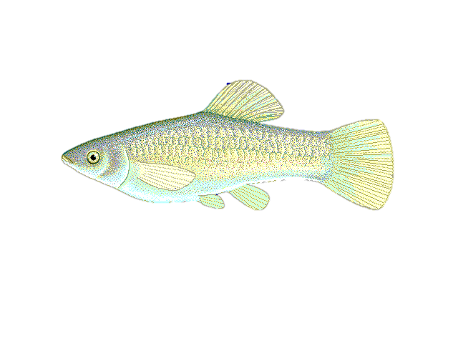
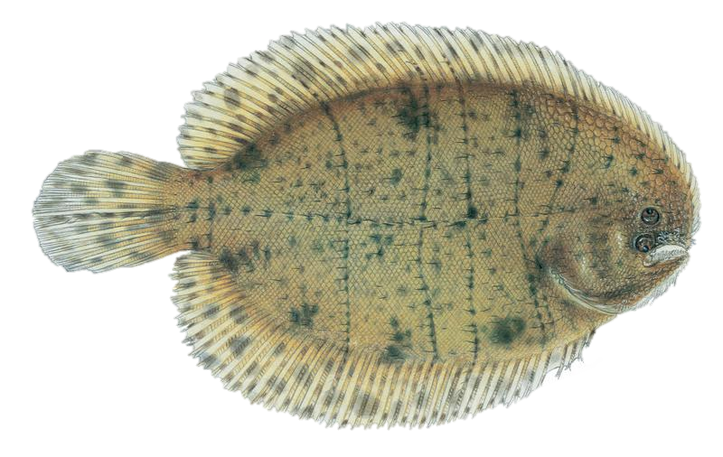
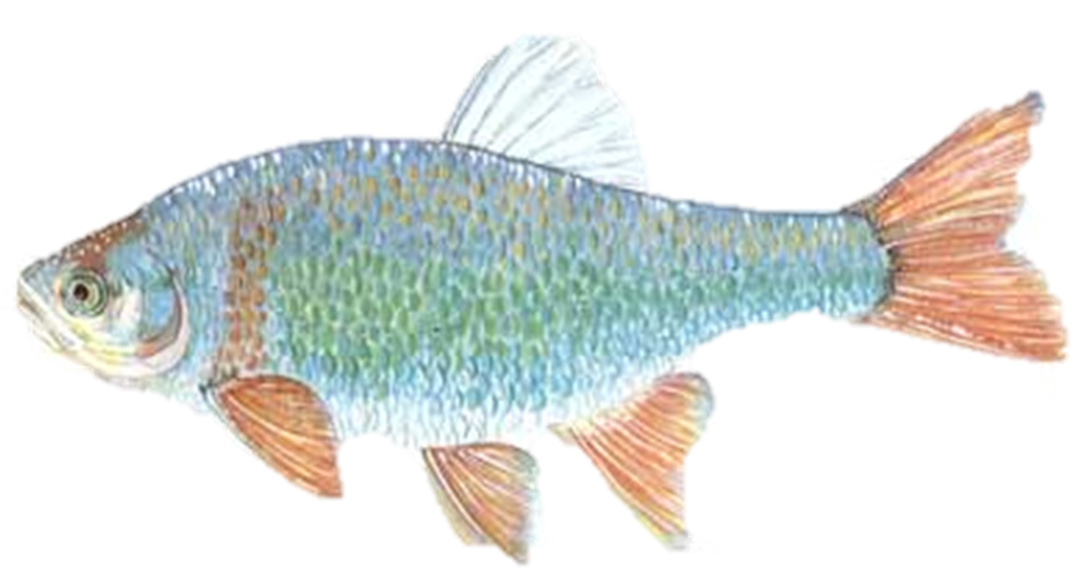
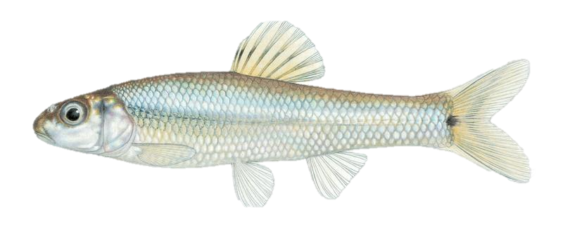
A
B
L. megalotis
L. macrochirus
Precipitation
(cm/yr)
L. cyanellus
10
Channel Shape
G. affinis
Precipitation
Flashiness
Conductivity
Species Richness
NH₄⁺
Low Flow Pulse %
5
A. amierus
P. latipinna
Y = 0.103(x) – 3.75
R² = 0.755
p = 0.002
C. lutrensis
T. maculatus
0
P. vigilax
80
100
120
Precipitation
Figure 3. (A) Fish diversity plotted against annual precipitation (cm/yr) (B) Fish community ordination using Hellinger transformation and redundancy analysis. Axes labels display the proportion of the variance explained as a percentage. Sites are represented by circles colored by annual precipitation indicated in the legend. Species are represented by red crosses, with species labels and reference images added to outer members. Environmental variables are shown in arrows and the significant ones are presented in red.

Slide 5
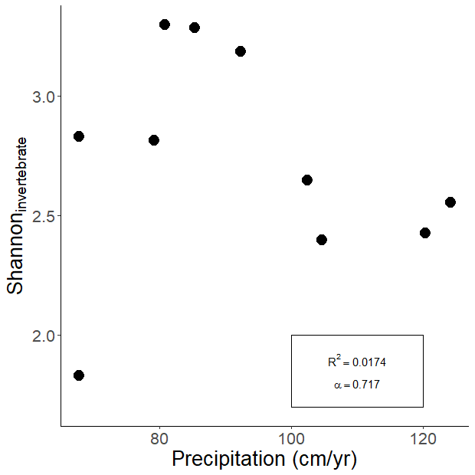
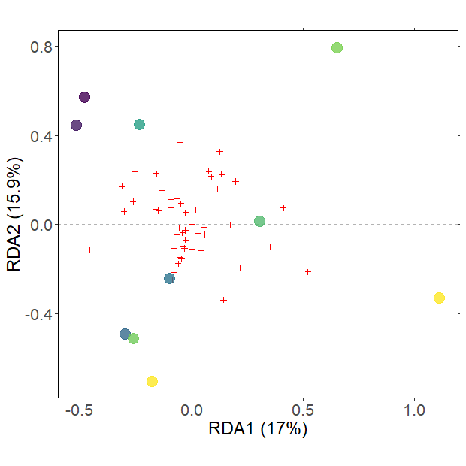
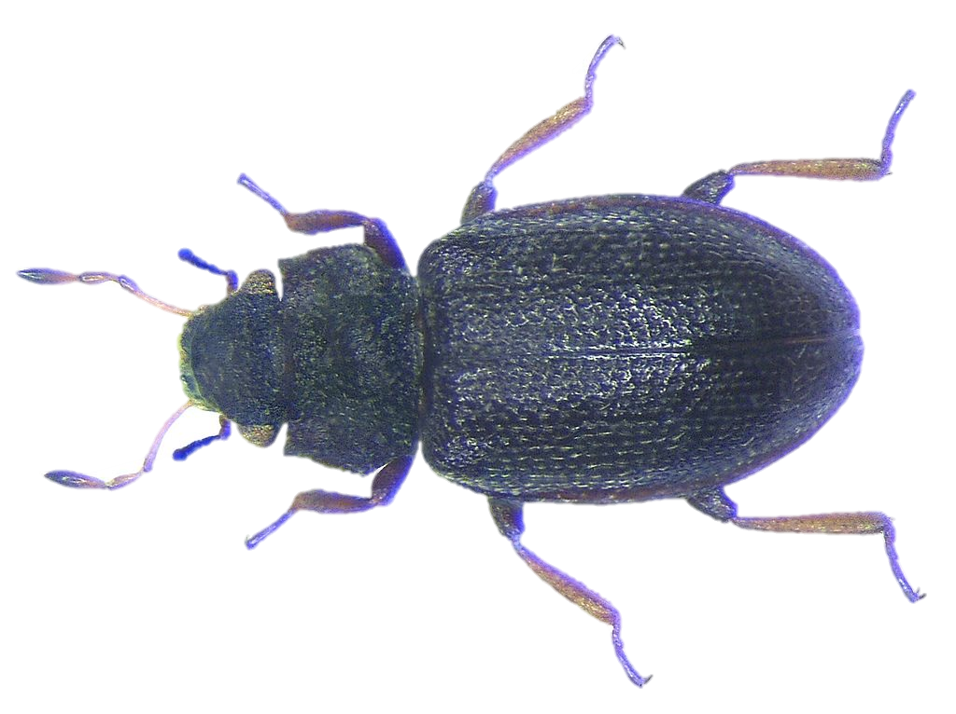
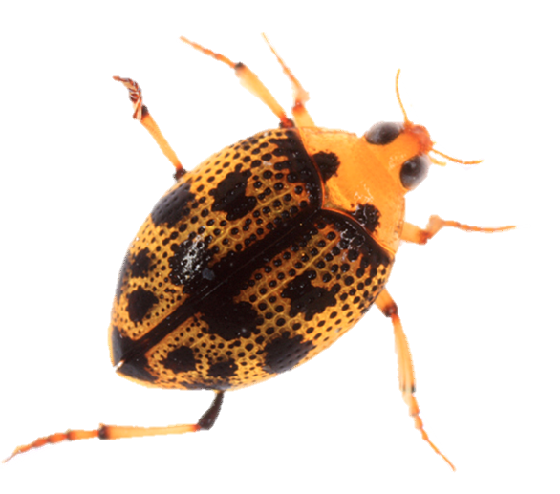
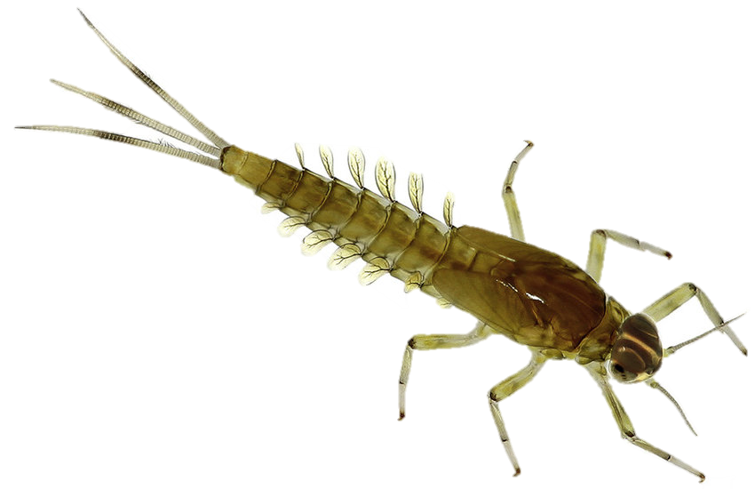
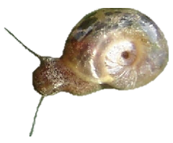
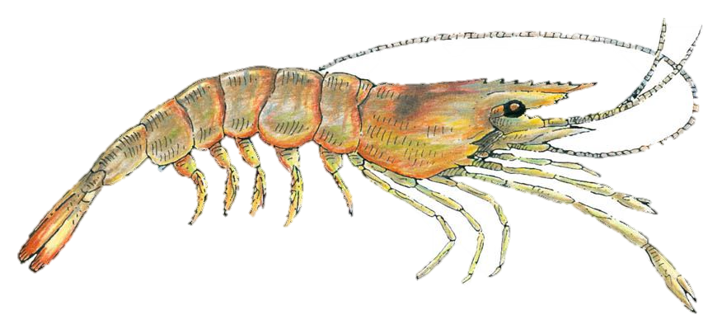
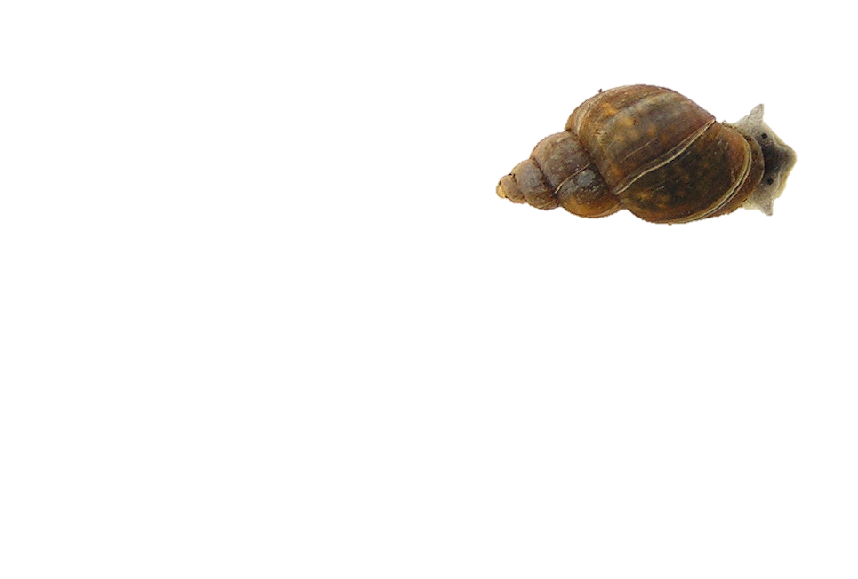
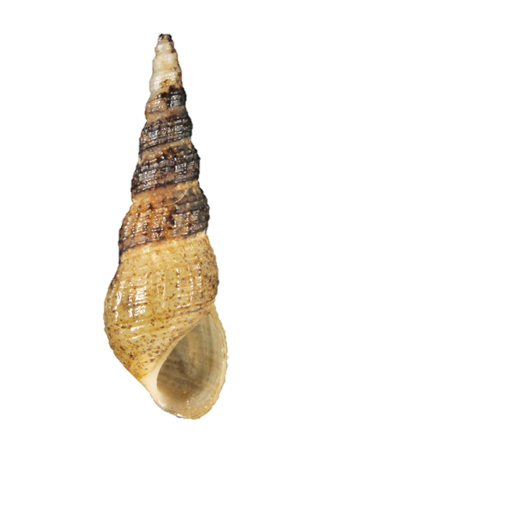
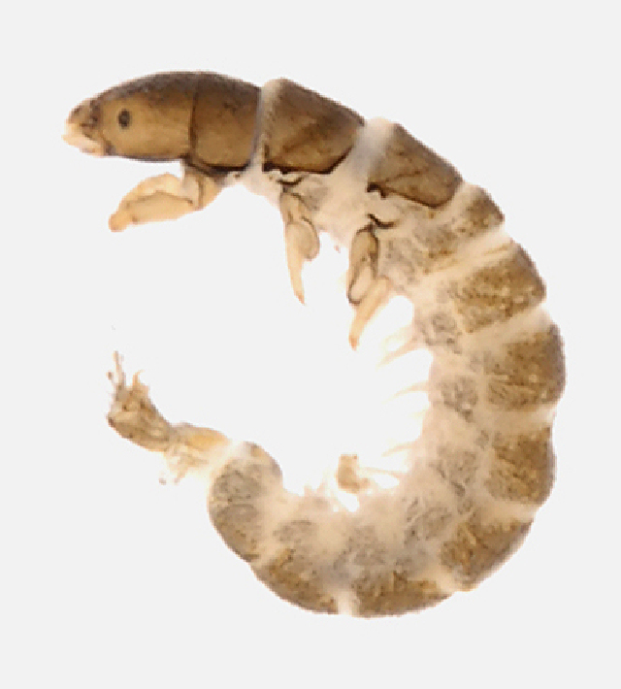
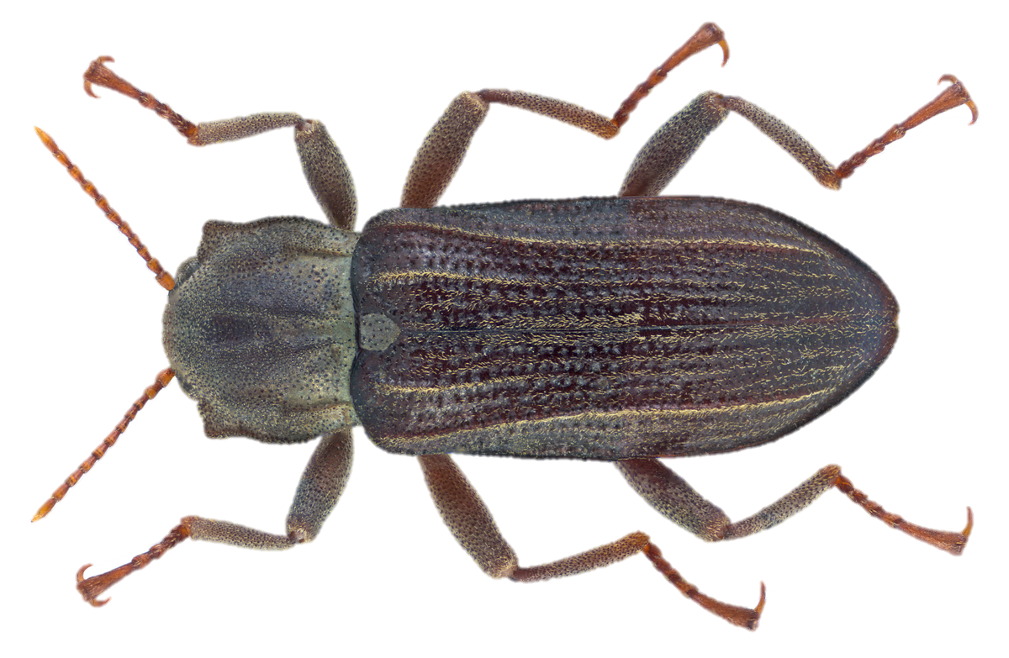
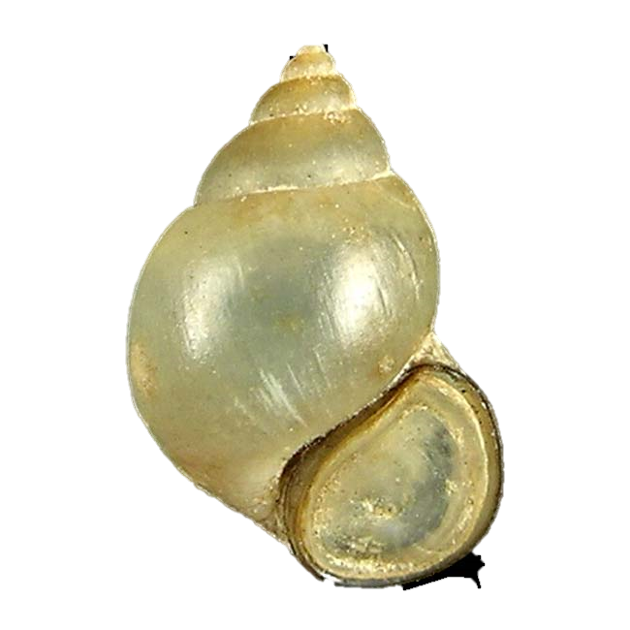
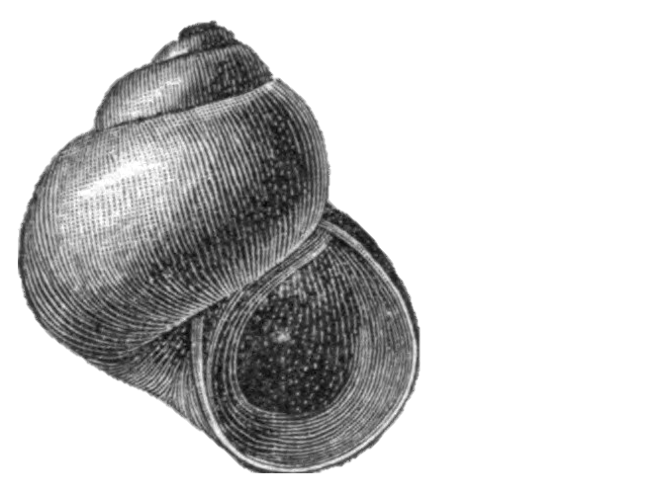
A
B
Hydraena
Peltodytes
Precipitation
(cm/yr)
Caenis
Channel Shape
Biomphalaria
Flashiness
Precipitation
Fossaria
Shannon Diversity Index
Palaemonetes
Melanoides
Conductivity
Cheumatopsyche
Low Flow Pulse %
NH₄⁺
Stenelmis
Bythinia
Amnicola
Figure 4. (A) Invertebrate diversity plotted against annual precipitation (cm/yr) (B) Invertebrate community ordination using Hellinger transformation and redundancy analysis. Axes labels display the proportion of the variance explained as a percentage. Sites are represented by circles colored by annual precipitation indicated in the legend. Species are represented by red crosses, with species labels and reference images added to outer members. Environmental variables are shown in arrows and the significant ones are presented in red.

Slide 6
Environmental Feature | Mean | Interquartile Range
Precipitaiton (cm/yr) | 92.5 | 24.6
Mean Air Temperature (°C) | 21.1 | 0.3
Minimum Air Temperature (°C) | 15.1 | 0.4
Maximum Air Temperature (°C) | 27.5 | 0.8
Elevation (m) | 29.9 | 32.0
Average Basin Slope (%) | 0.7 | 0.8
Human Development (%) | 13.3 | 5.8
Planted Cropland (%) | 41.8 | 23.9
Average Clay Content (%) | 30.5 | 4.6
Average Silt Content (%) | 31.0 | 2.1
Average Sand Content (%) | 38.5 | 3.9
Table 1: Mean and interquartile range values for environmental gradient features of 10 samples sites spanning the Texas Coastal Prairie. The source data was collected from US Geologic Surveyors Geospatial Attributes of Gages for Evaluating Streamflow, version II dataset (Falcone 2011).

Slide 7
Site Name | USGS Station ID | Precipitation (cm/yr) | Flashiness | Low Flow Pulse % | Channel Shape | NH₄⁺ (mg/L) | Conductivity ln(µS/cm)
Aransas | 8189700 | 80.770 | 1.053 | 7.664 | 11.781 | 0.105 | 6.835
Bear Branch | 8068390 | 124.190 | 0.777 | 13.146 | 12.011 | 0.133 | 5.426
Big Creek | 8115000 | 120.310 | 0.961 | 15.631 | 23.150 | 0.118 | 5.390
Garcitas | 8164600 | 102.410 | 0.806 | 4.867 | 18.161 | 0.098 | 6.249
Medio | 8189300 | 79.130 | 0.993 | 0.000 | 18.405 | 0.113 | 6.748
Mission | 8189500 | 85.360 | 0.580 | 3.357 | 14.701 | 0.170 | 7.163
Perdido | 8177300 | 92.370 | 1.339 | 0.000 | 15.152 | 0.075 | 6.602
Placedo | 8164800 | 104.650 | 0.921 | 5.482 | 13.380 | 0.088 | 7.035
San Fernando | 8211900 | 67.750 | 0.907 | 20.306 | 15.762 | 0.298 | 6.887
Tranquitas | 8212300 | 67.750 | 0.781 | 24.060 | 17.988 | 0.153 | 9.096
Table 2: Environmental values for the 10 sample sites. Annual precipitation, flashiness, and Low-Flow Pulse % were calculated using 30-year records provided by USGS stream gauges. Channel shape (stream width / stream depth), NH₄⁺, and conductivity were measured in-situ in during Spring 2017 sampling.

Slide 8
Response | Input | Sign | Slope | R² | F-stat | df | p-value | Multiple Regression
Shannon_{Fish} | Conductivity | - | 0.274 | 0.406 | 5.464 | 1 | 0.048 * | -
Shannon_{Fish} | Flash Index | + | 0.339 | 0.024 | 0.193 | 1 | 0.672 | +
Shannon_{Fish} | Low Flow Pulse % | - | 0.031 | 0.339 | 4.102 | 1 | 0.077 | - *
Shannon_{Fish} | NH₄⁺ | - | 4.647 | 0.446 | 6.431 | 1 | 0.035 * | -
Shannon_{Fish} | Precipitation | + | 0.017 | 0.602 | 12.101 | 1 | 0.008 * | + *
Shannon_{Fish} | Channel Shape | + | 0.021 | 0.027 | 0.224 | 1 | 0.649 | +
Shannon_{Invert} | Conductivity | - | 0.134 | 0.802 | 0.091 | 2 | 0.397 | -
Shannon_{Invert} | Flash Index | + | 0.623 | 0.65 | 0.075 | 2 | 0.443 | +
Shannon_{Invert} | Low Flow Pulse % | - | 0.035 | 5.591 | 0.411 | 2 | 0.046 * | - *
Shannon_{Invert} | NH₄⁺ | - | 0.065 | 0.001 | 0 | 2 | 0.980 | +
Shannon_{Invert} | Precipitation | - | 0.003 | 0.141 | 0.017 | 2 | 0.717 | -
Shannon_{Invert} | Channel Shape | - | 0.054 | 1.612 | 0.168 | 2 | 0.240 | -
Table 3: Univariate regression summary statistics and multiple regression relationships predicting fish and invertebrate Shannon Index values using environmental predictors. * denotes a p-value < 0.05 or an Δ AICc < 2.

Slide 9
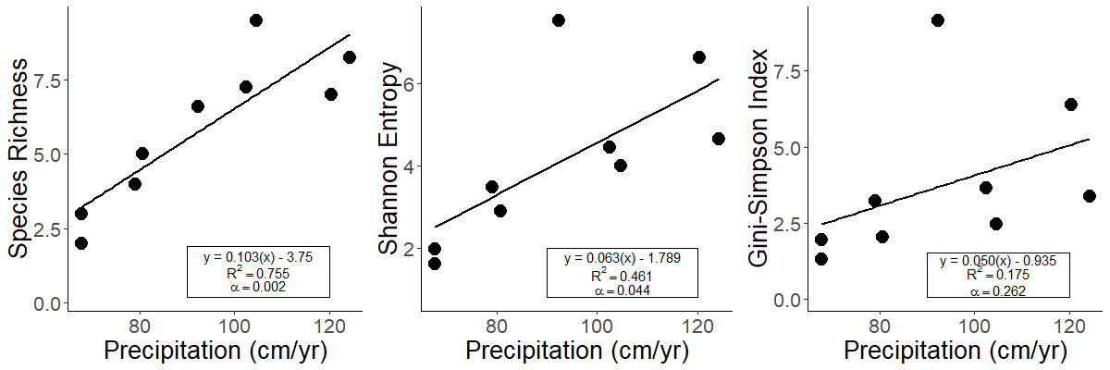
A
B
C
Supplement 1: Fish community (A) Species richness, (B) Shannon entropy, and (C) Gini-Simpson diversity plotted against annual precipitation. An Outlier at Mission River contained extremely high values for diversity metrics and was omitted from these plots and regressions. The Mission River diversity metrics are reported in the supplemental tables.

